Slide 1
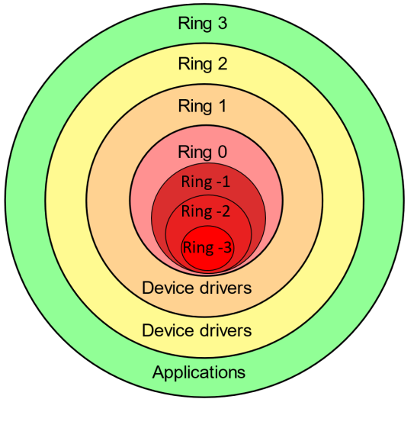
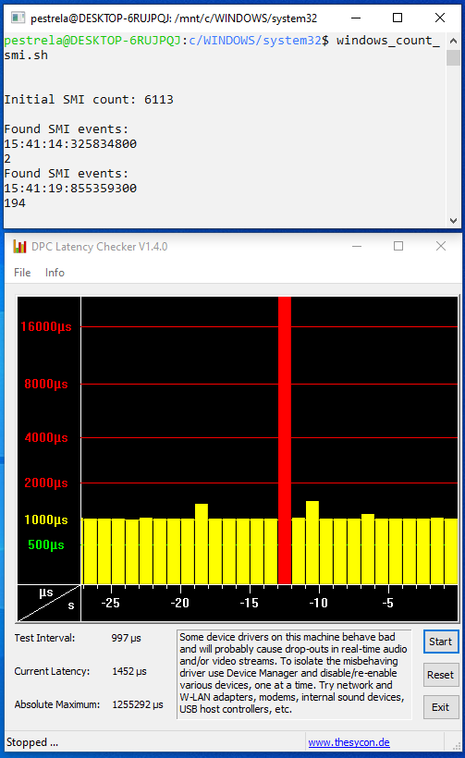
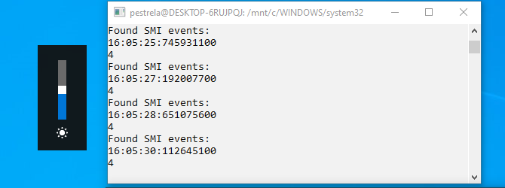
Ring | Name | Example | Privilege
+3 | Applications | Traktor | Least
+2 | Device Drivers
+1 | Device Drivers | Pioneer Driver
0 | Kernel | Windows Kernel
-1 | Hypervisor | Virtual Machine
-2 | System Management Mode | BIOS SMI
-3 | Intel Management Engine | Remote Admin | Most
RING -2 CONCEPT
AUDIO STOPS
FOR SECONDS
Dell XPS 15 9560 Bios 0.18.0
(0.16.0 same issue)
(1x event every 30m)
(10 hour test)
BRIGHTNESS = SMIs
(for control only)
Dell XPS 15 9560 Bios 0.18.0
https://en.wikipedia.org/wiki/System_Management_Mode
https://github.com/pestrela/smi_counter

Slide 2
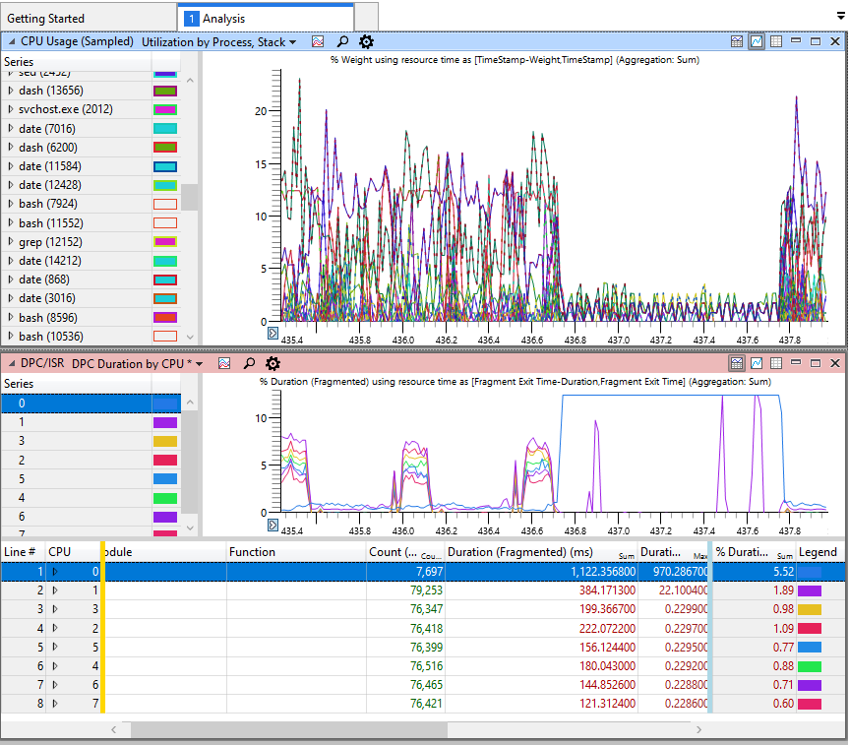
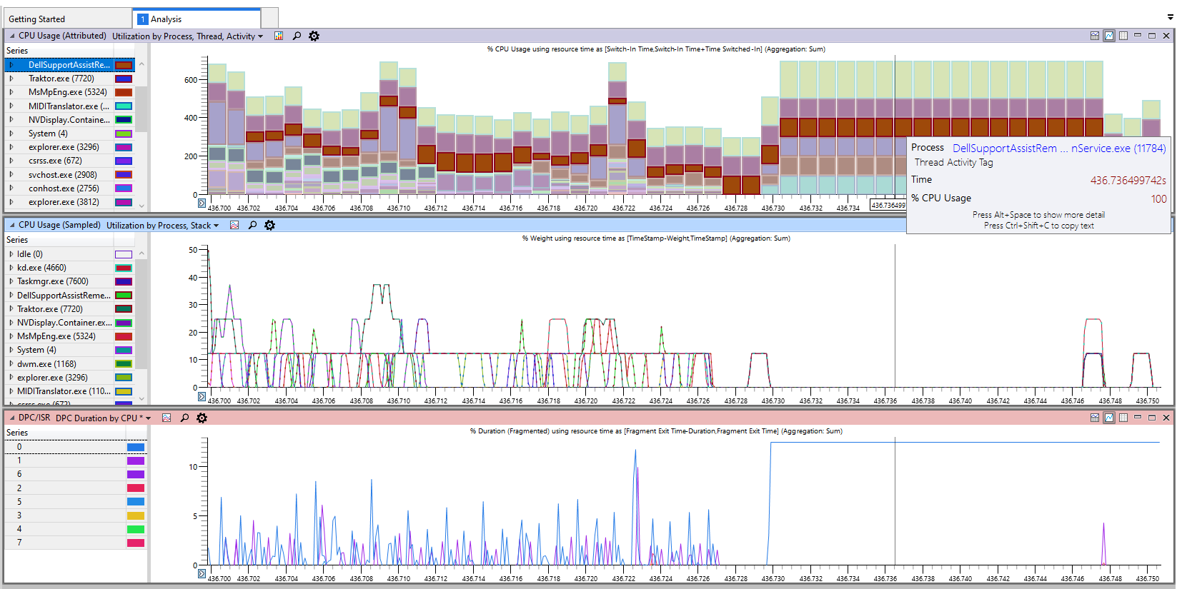
1 second
OVERVIEW (WPA)
ZOOM JUST BEFORE GAP
https://en.wikipedia.org/wiki/System_Management_Mode
https://github.com/pestrela/smi_counter

Slide 3
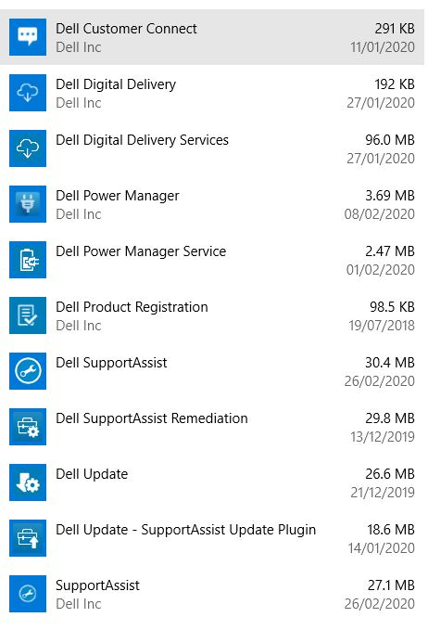
Remove these Programs in Add/Remove
https://github.com/pestrela/smi_counter

Slide 4
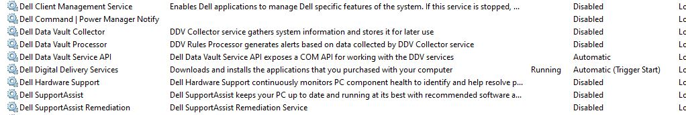
SERVICES.MSC
https://en.wikipedia.org/wiki/System_Management_Mode
https://github.com/pestrela/smi_counter

Slide 5
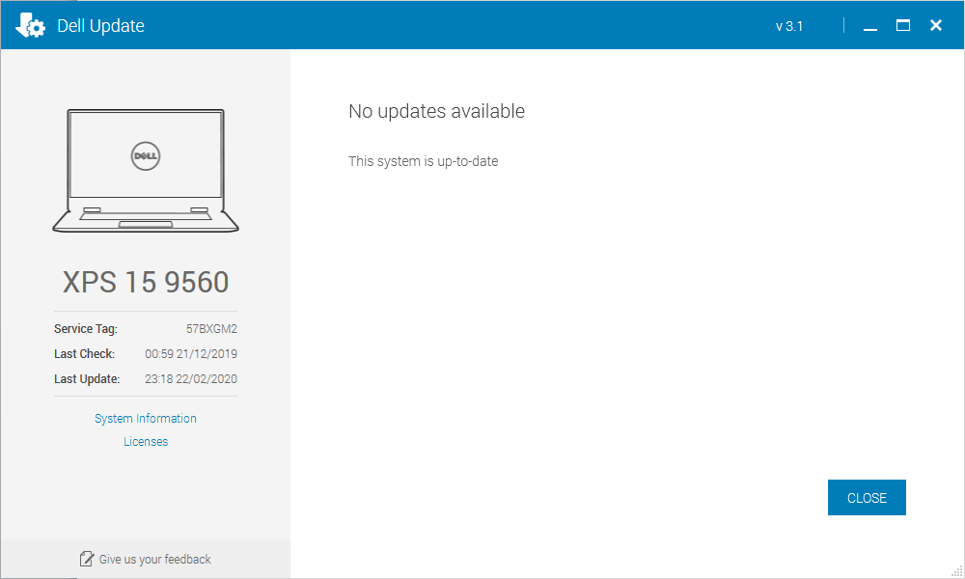
Dell updates

Slide 6
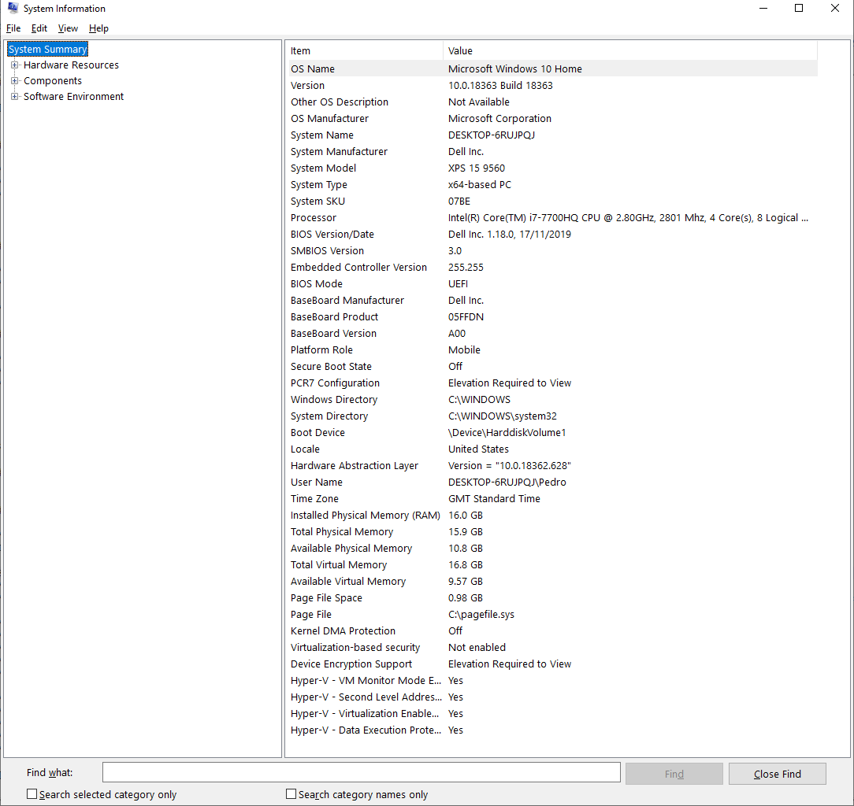
MSINFO32.EXE

Slide 7
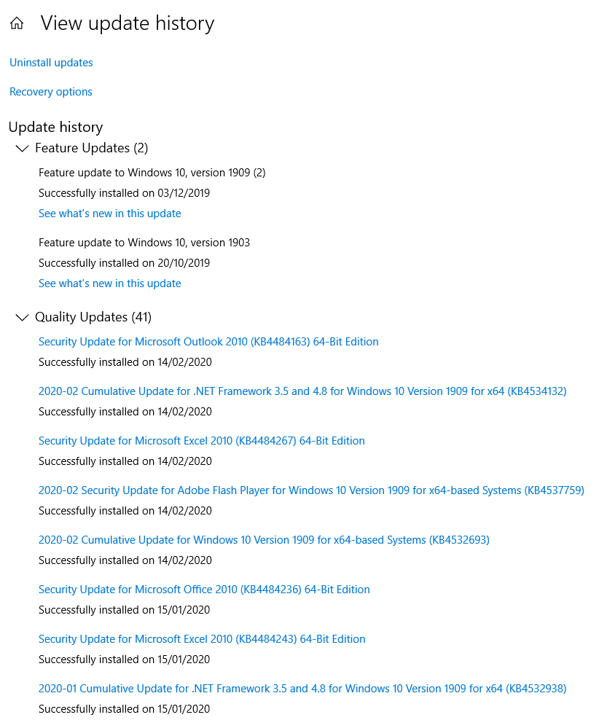
Windows updates

